Slide 1
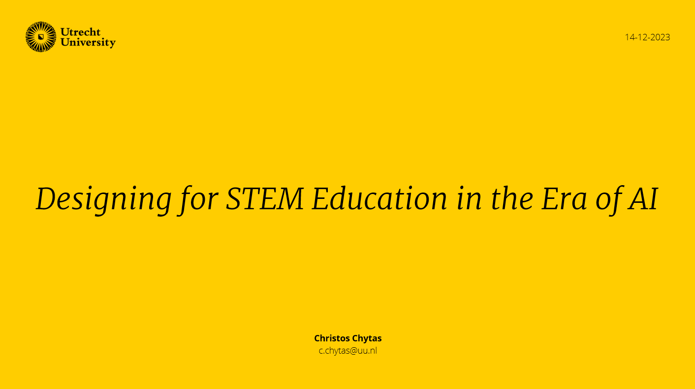
Designing for STEM Education in the Era of AI
(New date)
Christos Chytas
c.chytas@uu.nl
14 Dec 2023
And LLMs/GenAI as tools to think with rather than teacher replacement
Christos Chytas
c.chytas@uu.nl
Montserrat Dengra Grau
m.dengragrau@students.uu.nl

Slide 2
Main Topics
Challenges, critical considerations and future directions of AI
Integrating generative AI into the process of designing a course or lecture
Effective implementation of AI and best practices

Slide 3
Aim of this session
Workshop participants will be able to:
Responsibly use generative AI tools to design didactically sound and meaningful learning experiences within their courses or lectures.
Integrate AI within learning activities.

Slide 4
Warm up activity
How often do you use ChatGPT or similar AI Chatbots?
How do you use it in your professional/personal life?
Are you familiar with the UU's AI Code of Conduct?
Notes:
We could add a prompt about whether participants feel their current use of AI aligns with UU’s AI Code of Conduct (ethics, transparency, equity, sustainability…). This links personal practice to institutional expectations and could be a useful dimension to explore in a workshop.

Slide 5
Challenges, critical considerations and future directions of AI

Slide 6
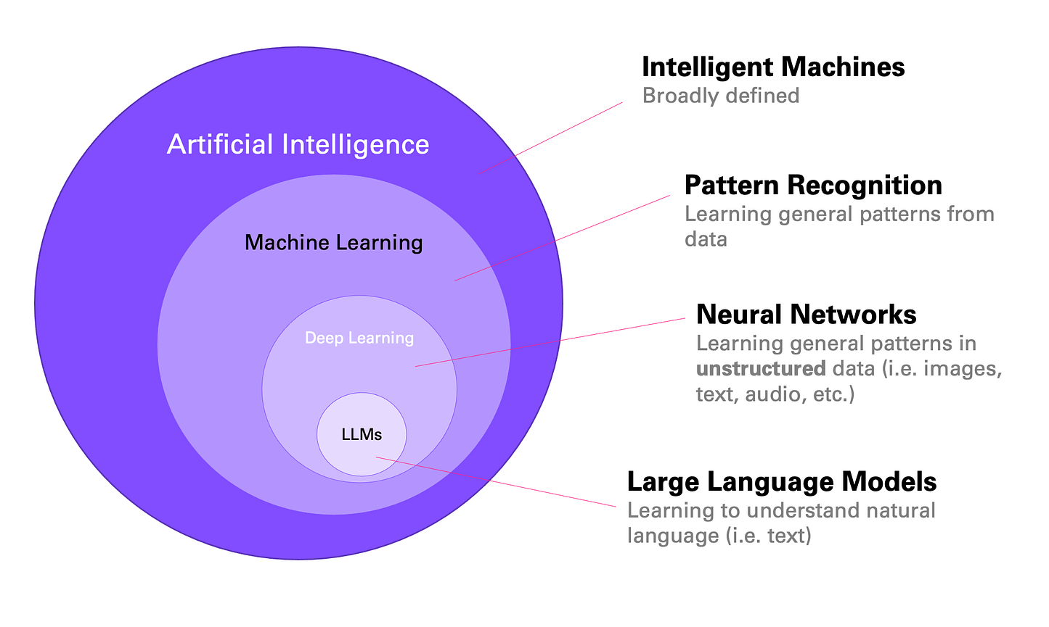
How do LLMs work?
Large Language Models (LLMs):
Are a type of models (like Generative Pre-Trained Transformers, or GPT) trained on massive amounts of text to predict the next word in a sequence
They generate human-like text, but don't understand meaning.
They identify statistical patterns, not truth.
LLMs produce “human-like” text not human thinking. Their power depends on how critically we use, verify, and contextualize their output.
Stöffelbauer, A. (2023). How Large Language Models work
Notes:
Stöffelbauer, A. (2023, 24 octubre). How Large Language Models work. Medium. https://medium.com/data-science-at-microsoft/how-large-language-models-work-91c362f5b78f

Slide 7
AI and Equity
AI and LLMs:
Can provide pedagogical support as a personalized learning tool
Can help with language barriers for non-native English speakers
Many of the GenAI tools require paid subscriptions.
Using external tools to reduce cognitive load may lead to a cognitive decline and worse skill development.*
AI systems can inherit and amplify human biases from the data they’re trained on
Can be economically infeasible and pollute the environment
*For further reading on 'Cognitive offloading' and it's effects: https://doi.org/10.3390/soc15010006
Notes:
O’Neil, C. (2017). Weapons of Math destruction: How big data increases inequality and threatens democracy. Crown. https://dl.acm.org/doi/10.5555/3002861

Slide 8
When using AI, have the following in mind:
Hallucinations by missing input:
Data Ownership:
Data Security:
Diversity and Biases:
AI tools can detect inconsistencies in input data (or that there is none). However, they do not have the capability to actively prevent or respond to missing or corrupt input and may "hallucinate". Always check for accuracy.
Most GenAI tools do not possess legal ownership over the data used to train them.
GenAI tools do not manage data storage or control access to specific datasets. Do not place personal data on platforms and consider disabling data training in the settings.
AI generates content based on the data they were trained on. This data tends to exclude diverse perspectives, which can produce biased responses. Critically assess and address these factors.
Notes:
Data Ownership: Most GenAI tools do not possess legal ownership over the data used to train them. They generate content based on patterns learnt from large datasets, whose ownership and usage rights lie with the organisations/publishers/individuals who provide the data.
Data Security: GenAI tools do not manage data storage or control access to specific datasets. They operate solely on pre-trained models and lack the capability to implement security measures for storage or restrict data access. Do not place personal data or unpublished data into unsecure platforms and consider disabling data training in the settings.
Diversity and Biases: GenAI tools generate content based on the patterns in the data they were trained on. This data tends to exclude diverse perspectives, which can produce biased responses. Critically assess and address these factors when using these tools.
Guarding Against Data Corruption: GenAI tools can sometimes detect inconsistencies in input data, which may suggest potential tampering. However, they do not have the capability to actively prevent or respond to tampering. Always check for accuracy.

Slide 9
Environmental Impact:
Informed Consent and Privacy:
Transparency and Attribution:
Integrity:
GenAI tools do not manage or handle informed consent. Do not input private information.
Many GenAI tools do not provide transparency or attribution regarding their responses. Communicate sources and methods used in our work.
Although guidelines, there are no hard rules regarding but integrity and accountability rely mainly in the user.
GenAI tools depend on data centers that consume large amounts of energy and water, particularly for cooling servers. Therefore, it is important to adopt a conscious and responsible approach its use.

Slide 10
AI tools we can use in STEM Education
Use | Tool
Programming | e.g., GitHub Copilot
Research assistance | e.g., ResearchRabbit, Connected Papers
Language and expression support | e.g., ChatGPT, Gemini, MetaAI...
Feedback
Brainstorming ideas
Assignment generation
Will the generated output be usable right away?
Notes:
I wonder if we could expand this slide a bit with some concrete examples of how teachers might actually integrate LLMs into their course design. For example, when talking about ‘Feedback’ it could be explained that LLMs can support the generation of adaptive practice exercises or multiple-choice questions to prepare the students before their tests (special remark on ‘DRAFT’ feedback, because these wouldn’t substitute the tests themselves).
In personalized learnign, it could say that it can be used to create discipline specific case studies/simulations (like in law and medicine) giving students structured scenarios to work with.

Slide 11
Activity
In pairs, discuss the following. Then, share your partner's answer with the rest of the assistants:
What is your main concern regarding AI use?
What's the most positive outcome that you have experienced by using AI?
Do you think educational design should keep in mind the use of AI by students?

Slide 12
Models, Frameworks and Theories as Guidance for design

Slide 13
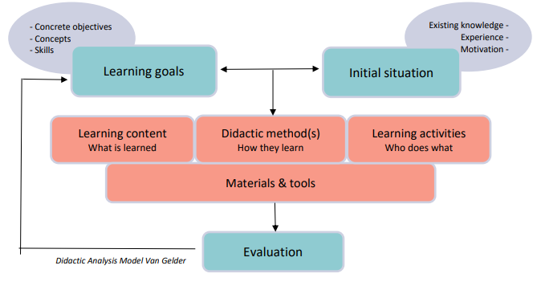
An example: Core elements of the Didactic Analysis Model
Notes:
Notes for self (I didn’t know what the Van Gelder model was):
The Van Gelder model is a framework to help teachers systematically design and analyze lessons: It looks at the teaching process as a set of interconnected elements that must align to make learning effective.The key idea: teaching works best when objectives, content, methods, and assessment all fit together. All these elements need to be aligned. For example: if your objective is “critical thinking,” your method can’t just be memorization, and your assessment shouldn’t just be multiple-choice recall.
Main elements in the model:
Objectives: What should students learn? (knowledge, skills, attitudes).
Content: What material is needed to achieve those objectives?
Didactic methods: How will the teacher present/explain/practice the content? (lectures, discussions, group work, etc.).
Media and resources: Which tools or aids will be used? (textbooks, AI tools, labs, slides).
Learning activities: What will students actually do to learn? (solve problems, create projects, reflect, experiment…?).
Assessment/evaluation: How will you check if the objectives are met? (tests, assignments, peer feedback).
Context: Who are the learners? What is the setting? What prior knowledge do they have?

Slide 14
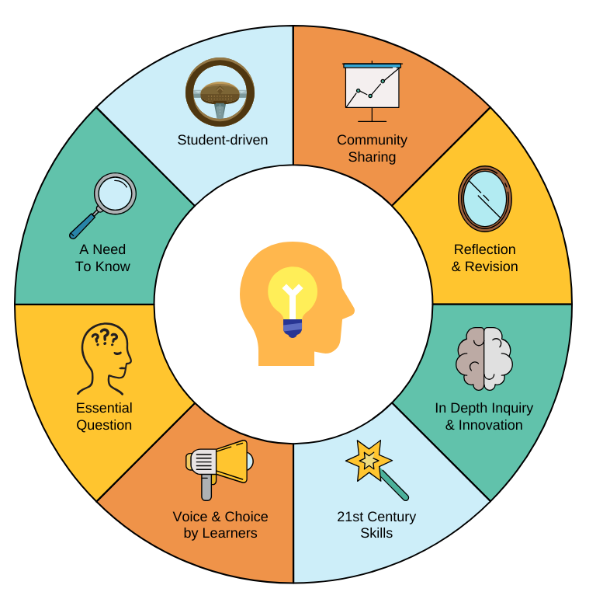
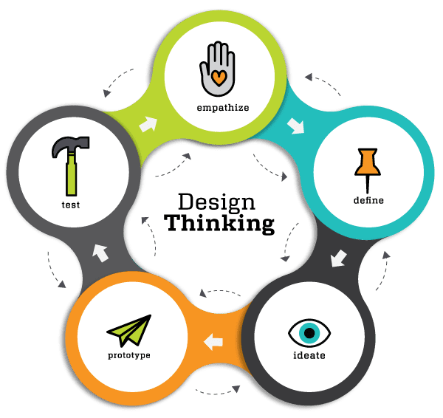
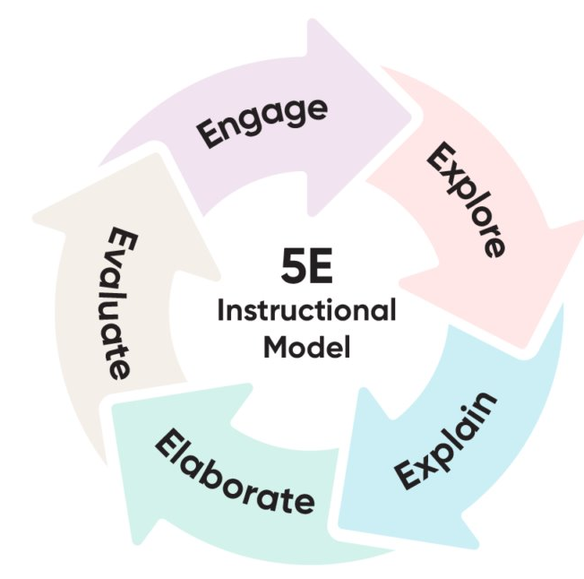
Other examples of models for educational design
Inquiry Based Learning
Inquiry Based Learning
Design Thinking Process
5E Instructional Model
Notes:
I wonder if we could expand this slide a bit with some concrete examples of how teachers might actually integrate LLMs into their course design. For example, when talking about ‘Feedback’ it could be explained that LLMs can support the generation of adaptive practice exercises or multiple-choice questions to prepare the students before their tests (special remark on ‘DRAFT’ feedback, because these wouldn’t substitute the tests themselves).
In personalized learnign, it could say that it can be used to create discipline specific case studies/simulations (like in law and medicine) giving students structured scenarios to work with.

Slide 15
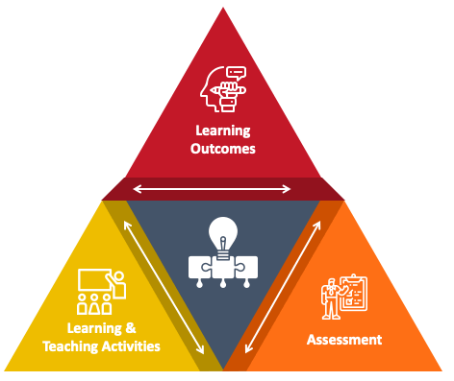
An example: Constructive Alignment
Either if there is AI usage or not, using a structured design model as guidance is useful.
The central idea of constructive alignment: creating an environment that supports what and how students learn and that leads to the intended results.
By aligning the learning activities and the assessment to achieve the same objective, you guarantee students will focus on matters relevant to the end goal.

Slide 16
Generating Design Ideas with LLMs
AI generated ILOs, activities and rubrics are usually very generic and broad
They usually lack domain expertise, contextual understanding and creativity
Biases
However:
May spark ideas for your design choices
Cognitive offloading
May provide good feedback and expand your perspective
Exploring alternative perspectives
Brainstorming
Expanding existing ideas

Slide 17
Prompting Tips
Be specific: Clearly define the task or question.
Include context: Add relevant background if needed.
Retain context: By working on the same chat
Set format expectations: Mention if you want a list, code, paragraph, etc.
Define constraints: Word limits, tone, audience, etc.
Avoid ambiguity: Use precise language.
Use examples: Provide one if the task is complex.
Test and refine: Iterate for clarity and effectiveness.
Ask an LLM To generate prompts
Dive deeper into prompting tips on: promptingguide.ai
Notes:
Could be useful to explain the type of prompt patterns as stated in White, Fu, et al. (2023). I include the classification as a picture in the slide. Knowing how the LLMs process input and generate output may be useful (but not completely relevant to the content of the workshop)

Slide 18
Prompts for supporting Constructive Alignment
“Are learning outcomes clear, measurable, and realistic?”
“Is student workload balanced across outcomes?”
“How will alignment be reviewed and improved after delivery?”
“How does each resource support aligned learning?”
“How do these assessments evidence achievement of each outcome?”
“Which teaching methods best prepare students for these assessments?”
“Where are the gaps between outcomes, activities, and assessments?”
“Do all tasks clearly map to specific outcomes?”
“Are diverse student needs considered in the alignment?”

Slide 19
Constructive Alignment
Intended Learning Outcomes (SMART)
Engaging Learning and Teaching Activities
Assessment that matches objectives

Slide 20
ILOs and SMART Learning Goals
SMART: Specific, Measurable, Achievable, Relevant, and Time-bound
Bloom’s taxonomy verbs: they describe cognitive levels that range from lower-order to higher-order thinking skills
Inclusive and fair for all students
Notes:
Notes for self (I didn’t know what Bloom’s taxonomy verbs were):
Bloom’s taxonomy is a hierarchy of cognitive skills, from lower-order to higher-order thinking. Teachers use verbs from Bloom’s taxonomy to write ILOs (intended learnign outcomes) in a measurable way. Levels and example verbs:
Remembering: define, list, recall, identify
Understanding: explain, summarize, classify, describe
Applying : use, demonstrate, implement, solve
Analyzing: compare, differentiate, examine, question
Evaluating: critique, justify, assess, argue
Creating: design, construct, formulate, produce

Slide 21
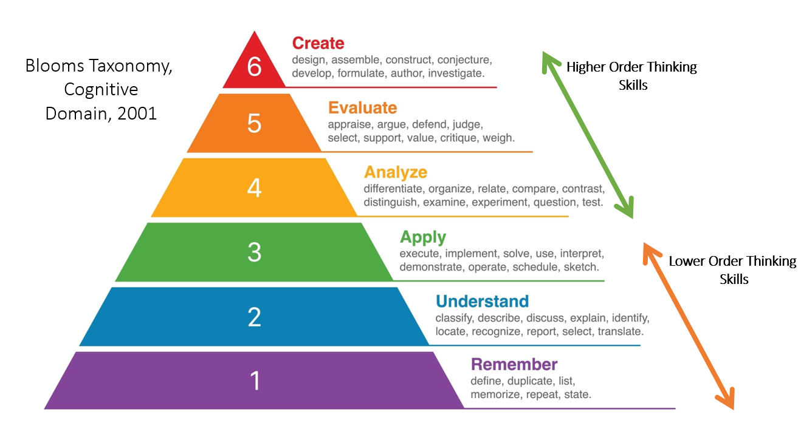

Slide 22
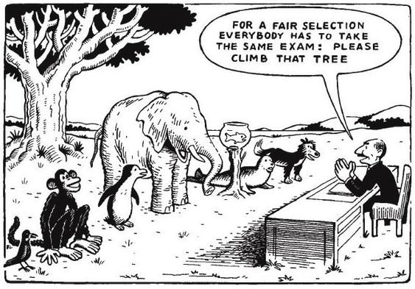
Practical ways to implement AI into SMART learning objectives
Making SMARTer learning objectives
Reducing bias and improving inclusion
"Help me make this goal more specific/measurable"
"Help me make this goal more inclusive to all students?"
"From an intersectional perspective, how can I make this goal more inclusive, fair, equity- centered?"
Notes:
What are some examples of using AI tackling human bias? It could be useful to give some prompts as to how AI can be used for that (and alo I think that in this poiint, possible Ai biases should be mentioned to avoid making LLM seem like objective machines, when they’re also biased depending on the models they were trained on).
(Write 1-2 slides on it)

Slide 23
Activity
Choose one of your current course learning objectives and use an AI tool to:
  Simplify the language of the objective and make it more specific, measurable, attainable, relevant and time-bound (SMART).
  Suggest two alternative versions that could accommodate diverse learners
Discuss in pairs:
  Did the AI-generated versions make the objective SMARTer or more inclusive?
  What risks do you notice (oversimplification, bias...)?

Slide 24
Designing for STEM Education in the Era of AI
(New date)
Christos Chytas
c.chytas@uu.nl
14 Dec 2023
And LLMs/GenAI as tools to think with rather than teacher replacement
Day 2
Christos Chytas
c.chytas@uu.nl
Montserrat Dengra Grau
m.dengragrau@students.uu.nl

Slide 25
Constructive Alignment
Intended Learning Outcomes (SMART)
Engaging Learning and Teaching Activities
Assessment that matches objectives

Slide 26
Relevant Learning Theories in STEM Education
Constructivism: learning is an active, constructive process where learners build new knowledge upon the foundation of previous understandings
Constructionism: people learn best through making concrete/tangible/personally meaningful projects and reflecting on their experiences

Slide 27
Activity
Divide into groups and discuss the following approaches:
Instruction designers should not be allowed from using generative AI in their education design
Instruction designers should be allowed to use generative AI for specific purposes, but not everything
Instruction designers should be allowed to use generative AI as they choose, as long as they disclose when they use it and take responsibility for the content it creates, including verifying all information.
Notes:
It should be in learning teaching activities

Slide 28

Key concepts to include in prompts:
Learning by doings, hands-on
Technology
Personalization
Problem-solving
Interdisciplinary/real-world applications
Creativity
Interactions
Social aspects
Relevant and personally meaningful
Notes:
Make it clearer that these bullets are meant to be included in prompts

Slide 29
Raising student awareness about policies, ethics and biases
Providing guidance on validating model-generated information
Requiring students to show where and how they used AI tools
Letting students use AI but not removing themselves from the thinking process
Encouraging having novel arguments or building on existing ones
Making the activity meaningful beyond AI usage
Ensuring equal availability of AI tools
When including AI use in learning activities, design should consider:
https://students.uu.nl/en/gsls/practical-information/generative-ai-guidelines

Slide 30
Activity
Break into small groups and give feedback for refining a learning activity for a course that you've taught (or would like to teach). Do it at first without AI and then ask a LLM to do it for you.
Keep in mind the principle of Constructive Alignment when reviewing your learning activity
Compare the two types of feedback: which aspects of the human and AI's feedback did you find most useful?

Slide 31
Constructive Alignment
Intended Learning Outcomes (SMART)
Engaging Learning and Teaching Activities
Assessment that matches objectives

Slide 32

Potential of AI in Feedback
Automatic grading, uploading students work to LLMs and relying on AI for high stakes decisions are not allowed under the UU AI Code of Conduct and EU AI Act
  “Check if my feedback uses consistent tone across all students regardless of who they are.”
  “Highlight areas where I may have graded too leniently or harshly compared to my other feedback.”
  “Suggest ways in which I can improve this feedback to be more assertive, inclusive and less harsh.”
AI can potentially help teacher comments to be effective but respectful in their approach
Potential for blind grading support:
Consistency in grading
AI can flag inconsistencies in grading across different students or groups
Inclusive, assertive and respectful feedback
AI tools could help anonymize student work (remove names, gender markers) so teachers focus only on content
Notes:
Alsaiari, O., Baghaei, N., Lahza, H., Lodge, J., Boden, M., & Khosravi, H. (2024, 19 octubre). Emotionally Enriched Feedback via Generative AI. arXiv.org. https://arxiv.org/abs/2410.15077

Slide 33
For activities that include AI usage:
The AIAS
(AI Assessment Scale)
1- NO AI | You must not use AI at any point during the assessment.
2- AI PLANNING | You may use AI for planning, idea development, and research. Your submission should show how you have developed and refined these ideas.
3- AI COLLABORATION | You may use AI to assist with specific tasks such as drafting text, refining and evaluating your work. You must critically evaluate and modify any AI-generated content you use.
4- FULL AI | You may use AI extensively throughout your work as you wish or as directed in your assessment. Focus on directing AI to achieve your goals while demonstrating your critical thinking.
5- AI EXPLORATION | You should use AI creatively to solve the task, potentially co-designing new approaches with your instructor.
https://aiassessmentscale.com/

Slide 34
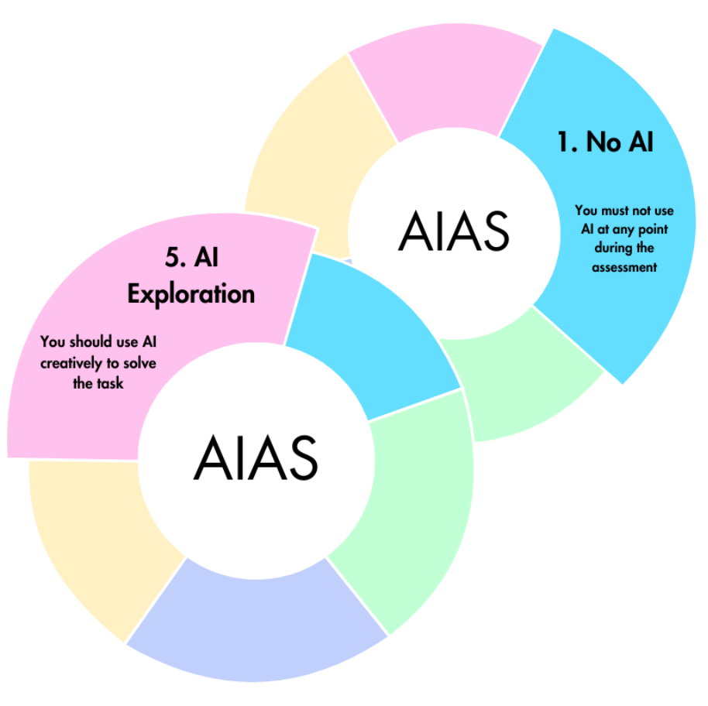
Suggestions for effective implementation of the AIAS
Clearly state the AI level permitted (1-5) and reinforce this through thetask design.
Redesign briefs and rubrics according to the AIAS level.
Prioritize multiple continuous evaluation over few high-stakes evaluations
Offer information and consideration on critical AI literacy and principles.
Make sure all students have access to necessary tools and resources, make it equal.
Align with the UU AI Ethical Code, prioritizing fairness.

Slide 35
Activity
In pairs, discuss the following:
  What are some unconscious biases that could affect the quality of an assessment?
  Do you think AI/LLMs can help with those types of bias? Why?

Slide 36
Concluding…
LLMs as tools rather than teacher replacement!
AI cannot replace:
Relationships, Community Building
Soft Skills, Social Skills
Ethical Considerations
Adaptability
Motivational, emotional, encouragement support
Mentorship
Context
Notes:
I think having an activity here where, taking this list into consideration, people write down or discuss 3-5 concrete teaching situations where LLMs SHOULD and should NOT be used and why. This way, teachers can remember this discussion in their daily lives more easily I think? It’s more impactful and easier to remember a situation where LLM should not be used if someone states a concrete situation that they come into in their practice regularly and discuss why they wouldn’t use AI. Also, I think this is one of the key takeaways of the workshop.

Slide 37
Final activity
Divide into (different!) groups and discuss the following points:
  Three areas where, as a teacher, you would now consider using AI in ways you had never used it before.
  Three areas where you believe AI should not be used, and what alternatives could be used instead.
Try to think of situations where you may have used AI in the past but would choose not to use it anymore.

Slide 38
Final questions to reflect on:
What are the potential benefits of this education design approach to AI?
What are the potential downsides?
Who will this approach impact the most?
When and how should teachers acknowledge their use of generative AI in their work?
Notes:
I think this type of discussion would be very nice to include in the final product. I really like the openness and it’s an inductive way to reach a risk and benefit analysis with experts.

Slide 39
Designing for STEM Education in the Era of AI
New date
Christos Chytas
c.chytas@uu.nl
14 Dec 2023
And LLMs/GenAI as tools to think with rather than teacher replacement
Christos Chytas
c.chytas@uu.nl
Montserrat Dengra Grau
m.dengragrau@students.uu.nl

